Slide 1
Machine learning

Slide 2
Machine learning is a subset of AI, which enables the machine to automatically learn from data, improve performance from past experiences, and make predictions. Machine learning contains a set of algorithms that work on a huge amount of data. Data is fed to these algorithms to train them, and on the basis of training, they build the model & perform a specific task.

Slide 3
How does Machine Learning work
A machine learning system builds prediction models, learns from previous data, and predicts the output of new data whenever it receives it. The amount of data helps to build a better model that accurately predicts the output, which in turn affects the accuracy of the predicted output.

Slide 4
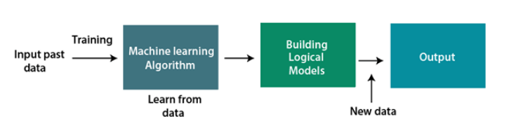

Slide 5
Types of data:
Structured, Semi-structured and Unstructured data

Slide 6
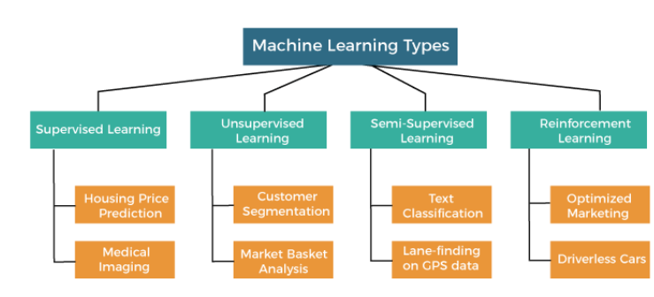
Types of ml:

Slide 7
Different types of algorithm classification regression
Random Forest Algorithm
Decision Tree Algorithm
Logistic Regression Algorithm
Support Vector Machine Algorithm
Simple Linear Regression Algorithm
Multivariate Regression Algorithm
Decision Tree Algorithm
Lasso Regression

Slide 8
Classification:
Logistic Regression:
Use when you have two categories to predict, like whether an email is spam or not spam.
Decision Trees: Good for understanding data with clear decision rules, like predicting if a customer will buy a product based on their age, gender, and income.
Random Forest: Ideal when you have a lot of data and want accurate predictions. It's like asking many people (trees) their opinion and then taking the majority vote.
.

Slide 9
Support Vector Machines (SVM):
Useful when you want to find a clear boundary between different groups, like classifying whether a tumor is benign or malignant based on its characteristics.
K-Nearest Neighbors (KNN): Handy for small datasets or when you want to find similar items, like recommending movies based on what similar users liked.
Naive Bayes: Works well with text classification tasks, such as spam detection or sentiment analysis in reviews.

Slide 10
Regression:
Linear Regression: Use when you want to predict a continuous value, like predicting house prices based on features like size, location, and number of bedrooms.
Ridge Regression: Helpful when you have many input features and want to prevent overfitting by penalizing large coefficients.
Lasso Regression: Similar to ridge regression but tends to perform variable selection by shrinking some coefficients to zero, thus selecting only the most important features.
Decision Trees: Suitable when you want to understand relationships between different variables and predict a numerical value, like predicting sales based on advertising spend, seasonality, and promotions.(RF)

Slide 11
LR: Explain. NLP(first project):

